Slide 1
Predicting Crime in Los Angeles, CA
Supervised Learning Capstone
11/5/19
Crystal Yang

Slide 2
Outline
How Can Data Aid the LAPD?
EDA
What are the most common types of crime?
When does crime happen most frequently?
Are there hotspots for crime?
Modeling
Baseline models
Improving the model
Optimizing models
Feature Importance
Conclusion and Future research

Slide 3


How Can Data Aid the LAPD?
Identify unsolved crimes with same perpetrator
Ex: a series of burglaries committed by the same criminal
Facial recognition
Reduce response time
Predict when and where a crime will occur
First step: identifying type of crime based on time and location
Use data from 2017-2018 to predict crime in 2019 based on location and time
https://www.bbc.com/news/technology-49726101
Photo by Sonja Langford on Unsplash

Slide 4
Data Available
Feature | Description
DR_ID | Official file number made up of the year, area ID, and 5 digits
Date and Time | MM/DD/YYY and military time format
AREA | 21 unique areas
Crime Description | Unique crime description and code
Coordinates | Latitude and longitude of the crime location

Slide 5
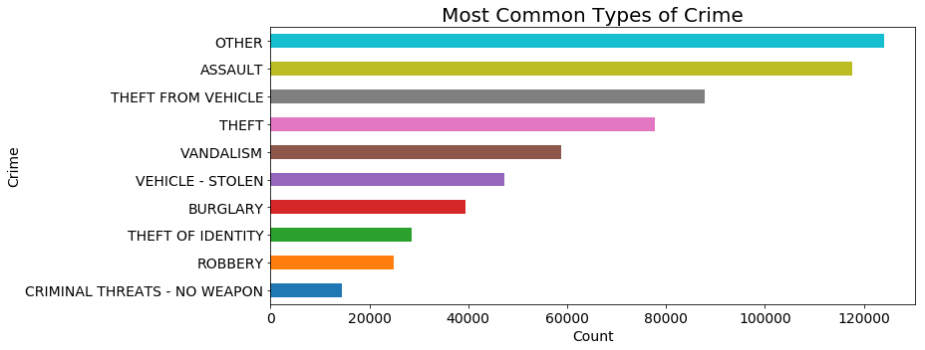
EDA – What Are the Most Common Types of Crime?
Originally 140 unique types of crimes
Top 16 most frequent crimes account for 80% of total crimes committed
Further reduced to 10 crimes
These are the target categories
Notes:
'other' (20%) are assault (19%), theft from vehicles (14%), and theft (13%).

Slide 6
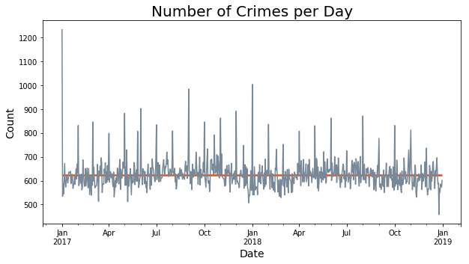
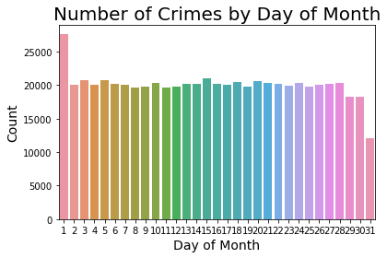
EDA – When is Crime Happening During the Year?
Total number of crimes steady from 2017-2018
Periodic spikes

Slide 7
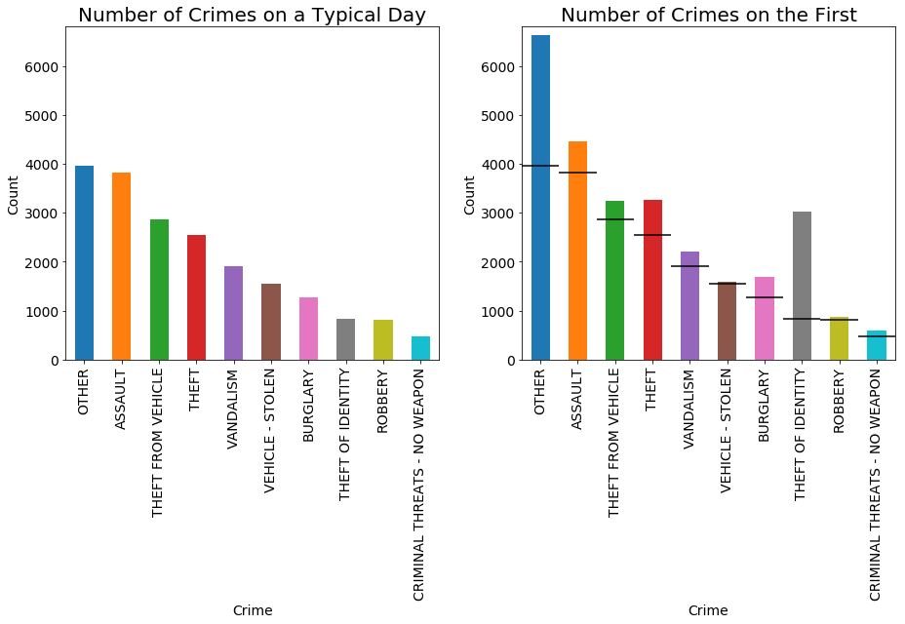
EDA – When is Crime Happening During the Year?
Horizontal lines are averages for a typical day
Crimes with drastic increase on the first of the month are other (50%) and theft of identity (115%)
Crimes with moderate increase are assault (15%), theft (25%), and burglary (28%)

Slide 8
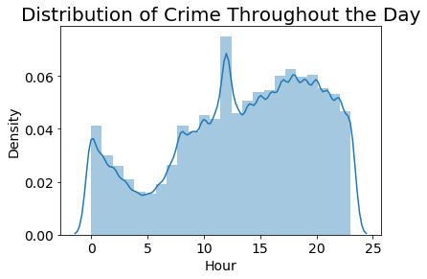
EDA – When is Crime Happening During the Day?
Crime is lowest at 5 AM, increasing until 6 PM before falling steadily till 5 AM
Anomaly at noon – huge spike

Slide 9
EDA – When is Crime Happening During the Day?
Horizontal lines are averages for a typical hour
Crimes with drastic increase at noon are theft of identity (150%), thefts (70%) and other (70%)
Crimes with moderate increases are assaults (20%) and burglaries (43%)

Slide 10
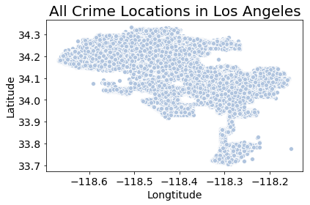
EDA – Are there Hotspots for Specific Types of Crime?
Angeles Forest
Topanga State Park
Torrance, CA
Carson, CA

Slide 11
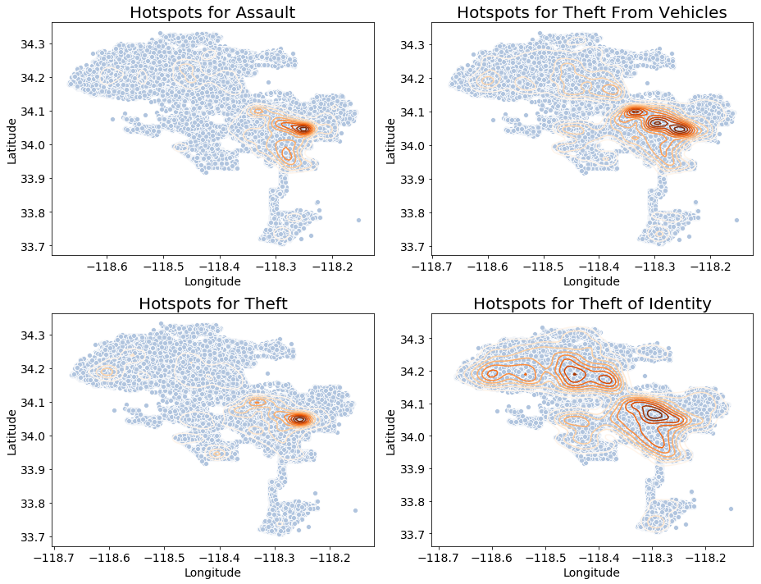
EDA – Are there Hotspots for Specific Types of Crime?
Most crimes have hotspots near downtown LA
Theft from vehicles occurred in touristy areas such as Hollywood and east Hollywood
Theft of Identity occurs in more affluent or touristy areas

Slide 12
Baseline Models
Training set – years 2017-2018
Test set - 2019
Model | Training Accuracy | Test Accuracy | Training Log Loss | Test Log Loss
Baseline Logistic Regression | 24.0% | 24.5% | 2.10 | 2.08
Baseline KNN | 51.8% | 29.7% | 1.01 | 12.96
Baseline Random Forest | 98% | 33.6% | 0.33 | 7.70
Baseline Gradient Boost | 39.4% | 38.8% | 1.63 | 1.65

Slide 13
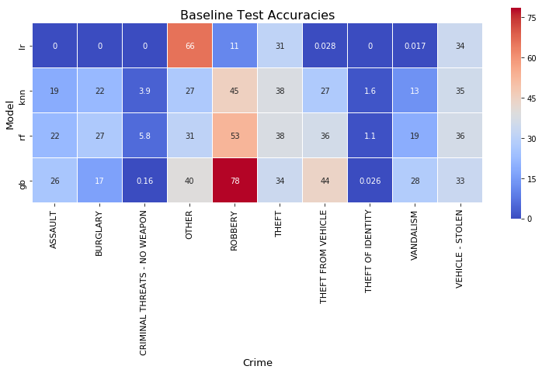
Baseline Accuracies
Most models predicted robberies the best
Logistic regression predicted ‘other’ crimes best
Recall that gradient boost had best model whereas logistic regression had the worst

Slide 14



How to Improve the Model?
Feature engineering
Holidays
External sources
Sports
Weather
Final dataset has 27 features
https://unsplash.com/photos/huyKOH2v4xE
https://unsplash.com/photos/diO0a_ZEiEE
https://unsplash.com/photos/hgGplX3PFBg

Slide 15
Optimized Models
Model | Training Accuracy | Test Accuracy | Training Log Loss | Test Log Loss
Final Logistic Regression | 24.2% | 24.7%, up 0.2% | 2.09 | 2.07, down 0.01
Final KNN | 33.6% | 32.3%, up 2.6% | 1.81 | 1.86, down 11.1
Final Random Forest | 81.0% | 37.3%, up 3.7% | 1.02 | 1.71, down 5.99
Final Gradient Boost | 40.2% | 39.1%, up 0.3% | 1.61 | 1.63, down 0.02

Slide 16
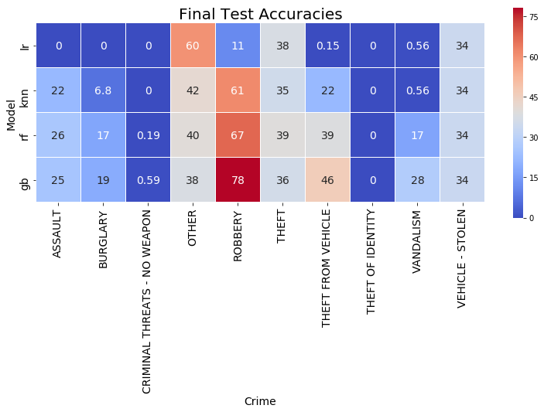
Optimized Accuracies
Doesn’t look drastically different from the baseline accuracies.

Slide 17
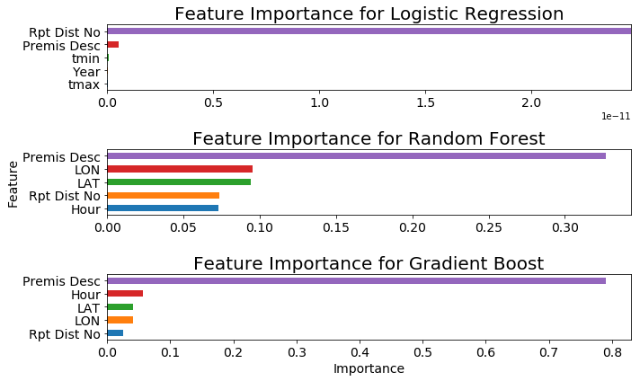
Feature Importance
How to Calculate Feature Importance
Feature importance for logistic regression: magnitude of the std dev * coefficient
Tree based models have built in functions for feature importance in sklearn
Observations
Logistic regression, the poorest model, relies heavily on district number
Tree based models have the same top 5 features with differing orders
Same 5 top features
Recall they were the two best models

Slide 18

Conclusions
The best model was gradient boost, with 39% accuracy and 1.64 log loss score
If time is a concern, then random forest is a good alternative, with 37% accuracy and 1.71 log loss score
The most important features are district number, location, and time of day
Future Research
‘Other’ category is masking a crime that is an anomaly at noon and the first of the month. This crime should be revealed
The model can probably be improved -> more feature engineering/external sources
Ex: distance from a point of interest or police station
Recent study showed that when US cities experienced unusually high pollen count, violent crimes decreased (https://www.sciencedirect.com/science/article/abs/pii/S0167629618308221)
https://unsplash.com/photos/rTO4hjAgbDU

